Slide 1
Clustering the neighbourhoods of London
Harshil Desai
15th May,2021

Slide 2
London is a city with a high population and population density. Being such a crowded city leads the owners of shops and social sharing places in the city where the population is dense. When we think of it by the investor, we expect from them to prefer the districts where there is a lower real estate cost and the type of business, they want to install is less intense. If we think of the city residents, they may want to choose the regions where real estate values are lower. At the same time, they may want to choose the district according to the social places’ density. However, it is difficult to obtain information that will guide investors in this direction. When we consider all these problems, we can create a map and information chart where the real estate index is placed on London and each neighbourhoods is clustered according to the venue diversity. This will simplify our process for opening a venue in given a particular location.
INTRODUCTION:

Slide 3
Data sources: The data that I have used are as follows: 1.The neighbourhood data from Wikipedia page. 2.The house price data is taken from united kingdom government website. 3.I used Forsquare API to get the most common venues of given neighbourhood of london

Slide 4
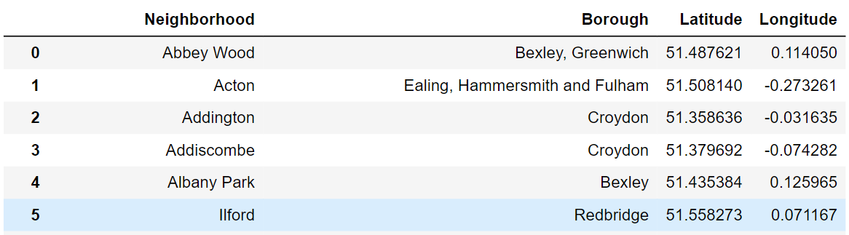
Here we have dataframe that contain neighbourhood name , borough name, latitude and longitude of neighbourhood.

Slide 5
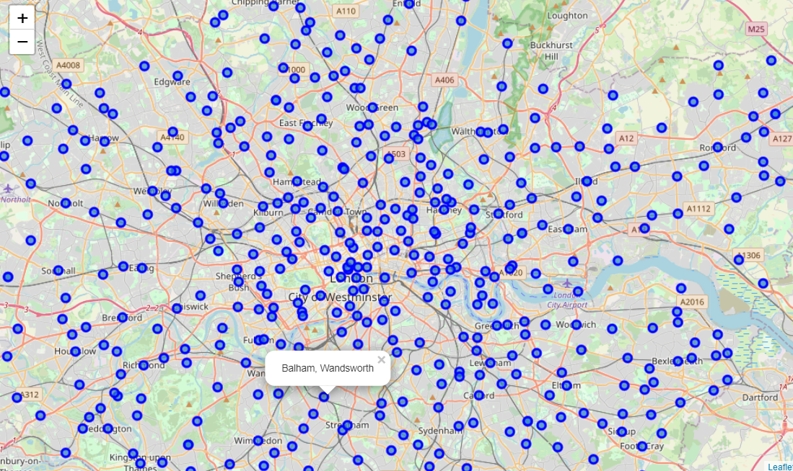
Visualize the data

Slide 6
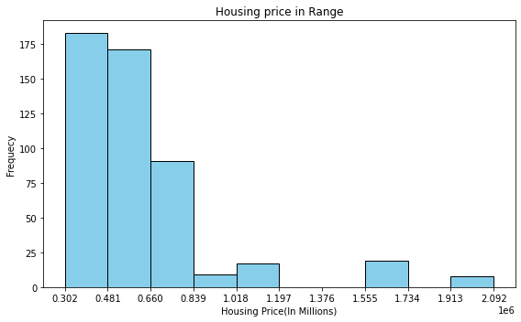
Categorized neighbourhood by house price
Price(In GBP) | Category
Less than 481000 | Low_Level_HSP
Between 481000 - 839000 | Mid-1_Level_HSP
Between 839000 - 1197000 | Mid-2_Level_HSP
Between 1197000 - 1734000 | High-1_Level_HSP
Greater than 1734000 | High-2_Level_HSP

Slide 7
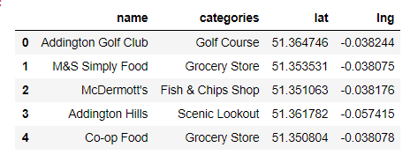
Head of venues returned by Forsquare

Slide 8
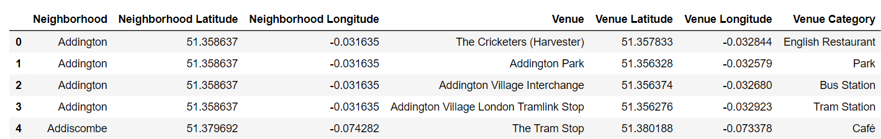
Merged table of venues and neighbourhood

Slide 9
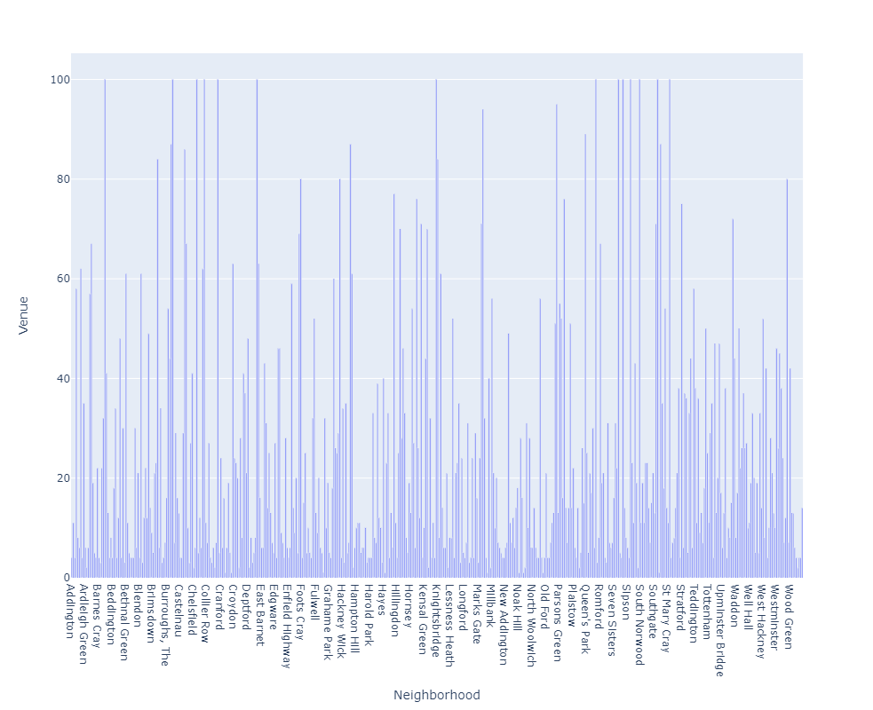
Venues in each neighbourhood

Slide 10
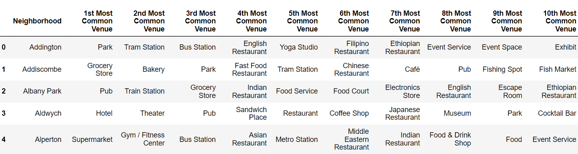
Top 10 venue category for each neighbourhood

Slide 11
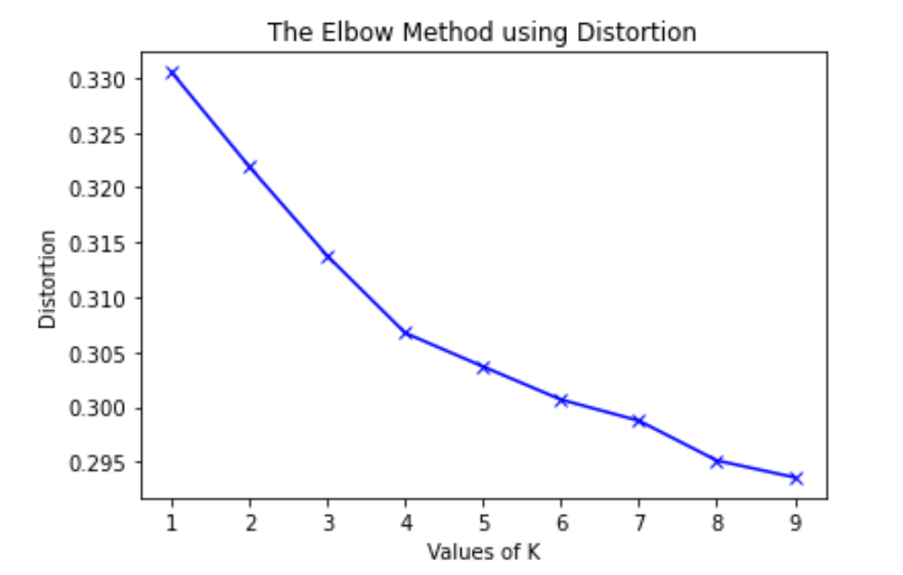
Elbow method for optimum k

Slide 12
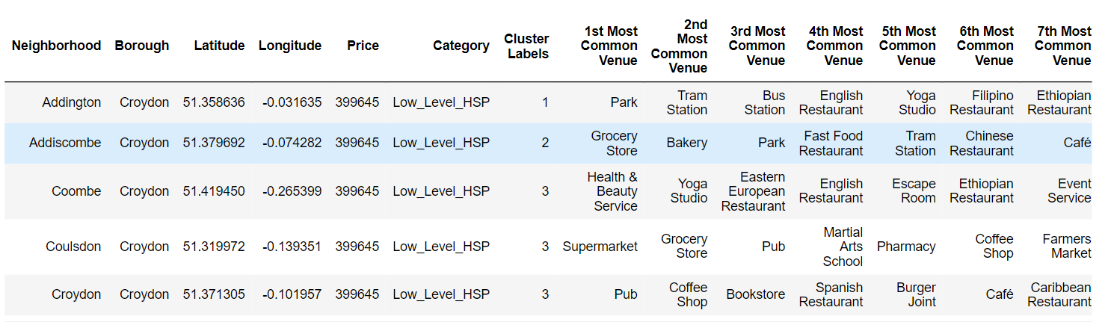
merged table with cluster number

Slide 13
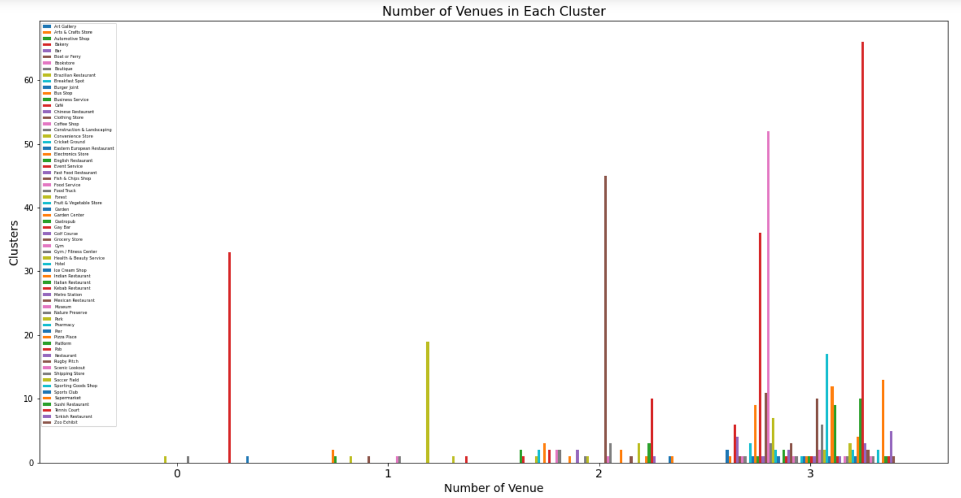
1st Most Common Venue in each cluster

Slide 14
categorizing the clusters
Cluster number | Cluster Type
cluster 0 | Pub venues
cluster 1 | park venues
cluster 2 | grocery & pub
cluster 3 | all social venues

Slide 15
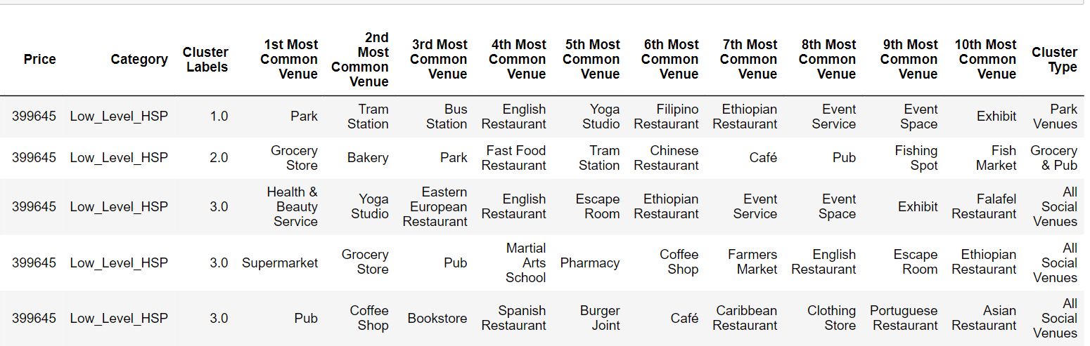
Adding cluster label in table

Slide 16
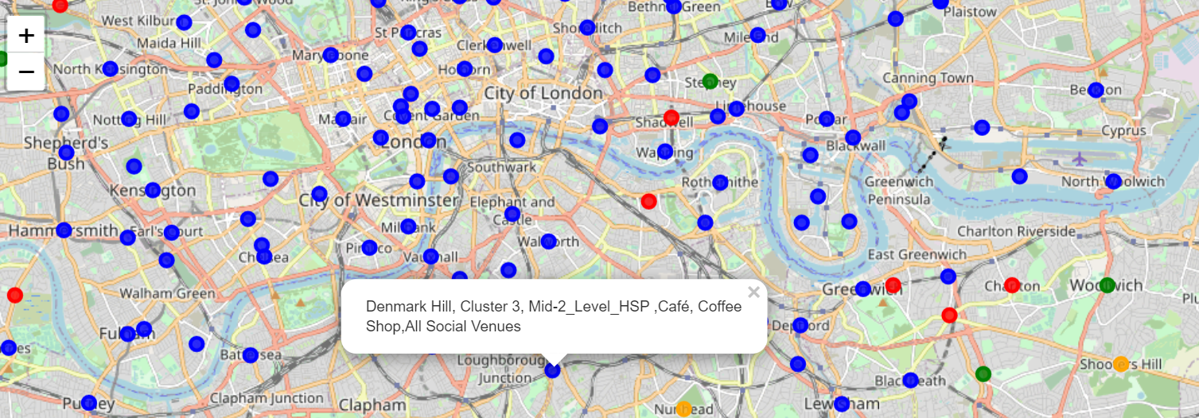
Clustered map with label

Slide 17
Discussion&conclusion
As I mentioned before, London is a big city with a high population density . As there is such a complexity, very different approaches can be tried in clustering and classification studies. Moreover, it is obvious that not every classification method can yield the same high quality results for this busy city.
I used the K-means algorithm as part of this clustering study. When I tested the Elbow method, I set the optimum k value to 4. For more detailed and accurate guidance, the data set can be expanded and the details of the neighbourhoods can also be scrutinized.
I ended the study by visualizing the data and clustering information on the London map. In future studies, web or telephone applications can be carried out to direct investors.
As a result, people are turning to big cities to start a business or work. For this reason, people can achieve better outcomes through their access to the platforms where such information is provided.
Not only for investors but also city managers can manage the city more regularly by using similar data analysis types or platforms

Slide 18
Thank YOU!!!

